Slide 1
Bayesian Hypothesis Testing
An Introduction

Slide 2
Welcome

Slide 3

Overview
Introduction to (Bayesian) Statistics
Probability and Bayes’ Rule
Bayesian Reasoning
Likelihoods and Bayes Factors
Hypothesis Testing
Using JASP
Bayesian Hypothesis Testing in Practice

Slide 4


Slide 5
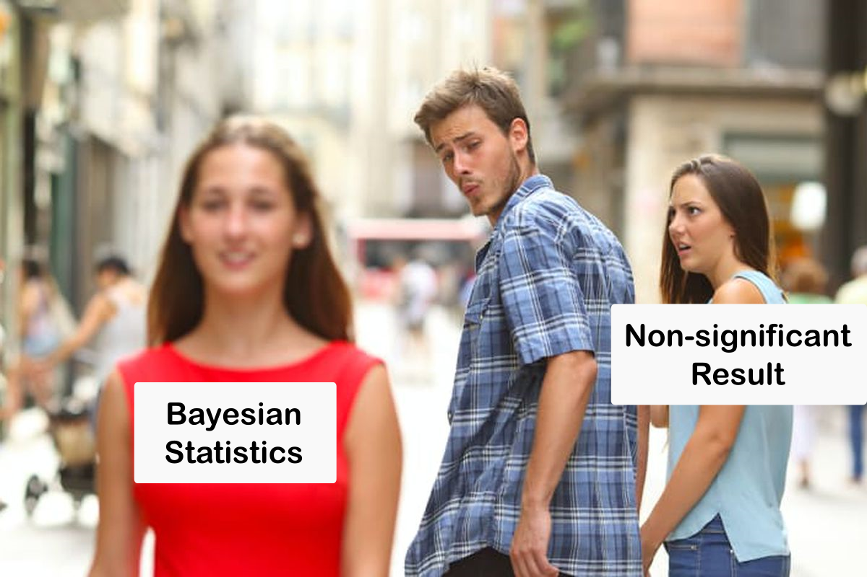

Slide 6
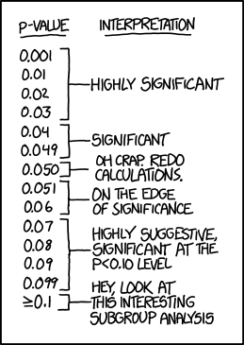

Slide 7

Introduction to (Bayesian) Statistics
Probability

Slide 8
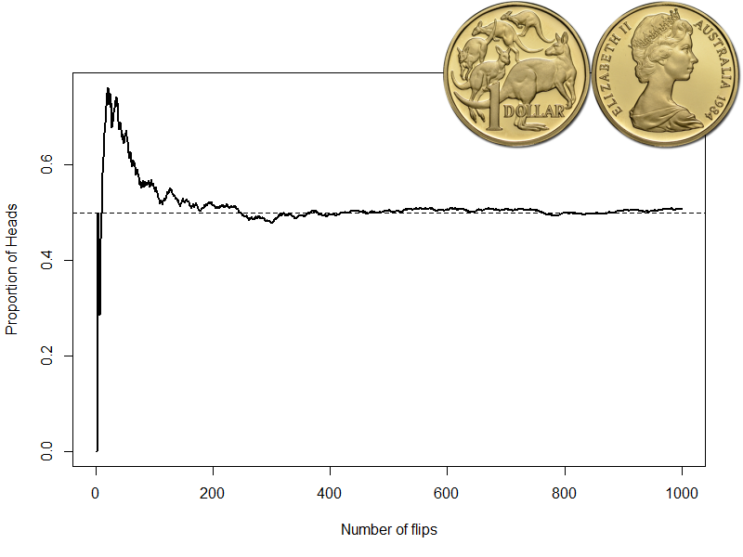
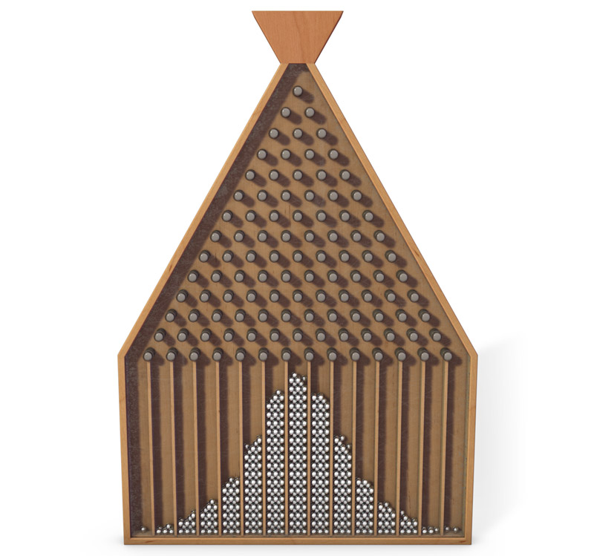
What is Probability?
The Frequentist view
Probability is an objective characteristic of physical processes.
The probability of a particular outcome is defined as its relative frequency when the process is invoked repeatedly.

Slide 9
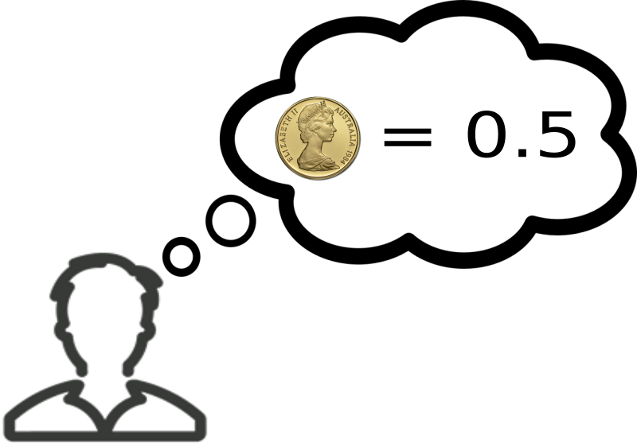
Frequentist Statistics
Experiments and Hypotheses
An experiment is a repeatable procedure. Probabilities can be used to describe its outcome.
A Hypothesis is not repeatable. No probability can be attached to it.

Slide 10

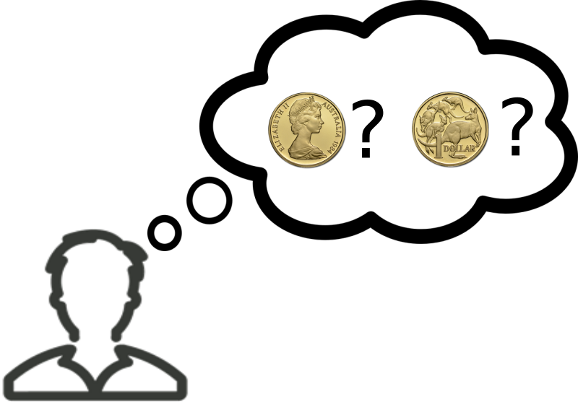
What is Probability?
The Bayesian View
Probability is a subjective characteristic of rational agents.
It is defined by assessing the strength of the belief the agent holds in a proposition.

Slide 11

Bayesian Statistics
Experiments and Hypotheses
Probability can be attached to any statement that an agent can believe.
Experiments generate events about which an agent may hold beliefs.
A hypothesis consists of propositions about which a rational agent might hold believes.

Slide 12
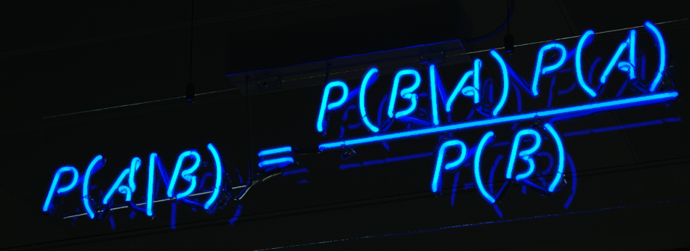
Introduction to (Bayesian) Statistics
Bayes’ Rule

Slide 13

Let’s roll two dice…
Roll two dice and add them together.
How likely are the different possible outcomes?

Slide 14
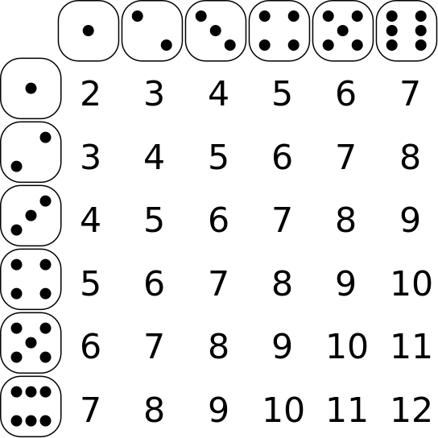
36 different rolls…
Each roll produces an outcome between 2 and 12.
Some outcomes are more common than others.

Slide 15
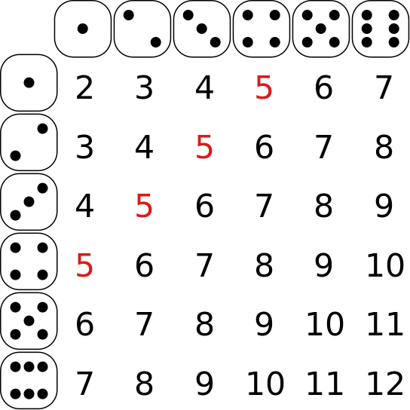
Of the 36 possible rolls, four add up to 5.

Slide 16
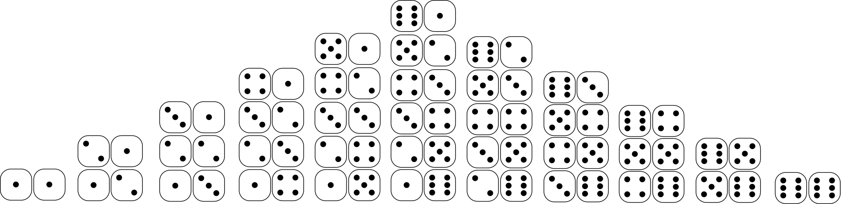

Slide 17
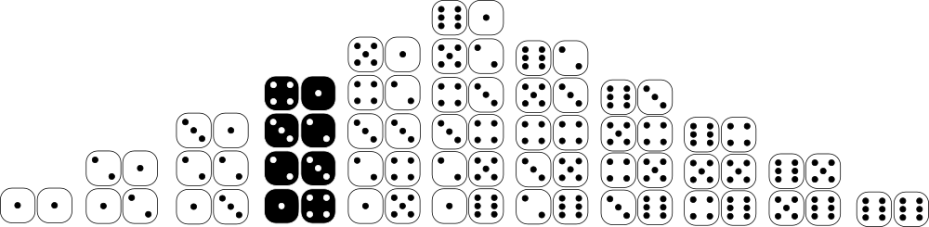
“Roll a 5”
4/36 = 0.111

Slide 18
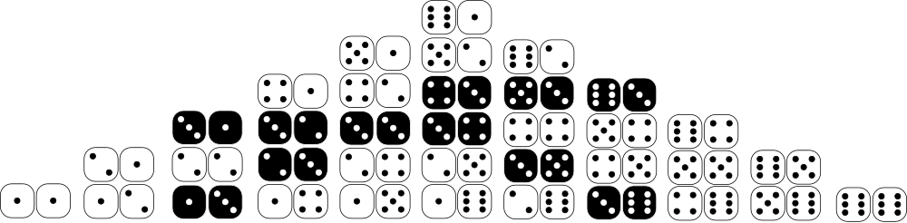

A: “At least one die shows a 3”
$$P\left(A\right)=\frac{11}{36}=0.31$$

Slide 19
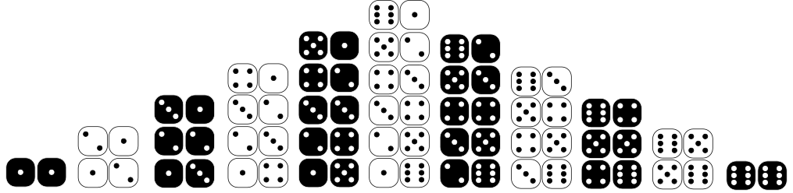

B: “Roll is even”
$$P\left(B\right)=\frac{18}{36}=0.5$$

Slide 20
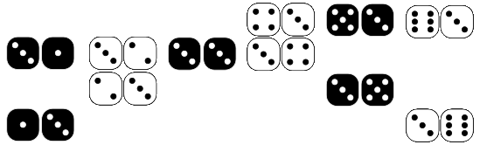
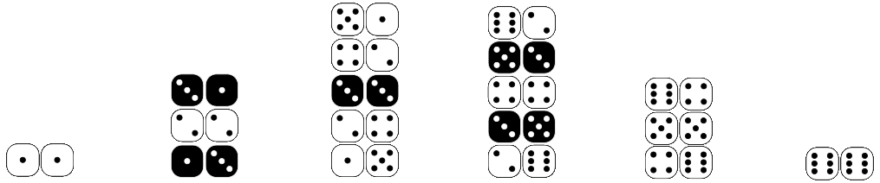
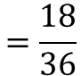
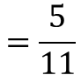
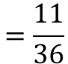
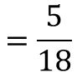
$$=\frac{11}{36}$$
$$=\frac{5}{11}$$
Probability that roll contains at least one 3
Probability that roll is even given that
at least one die is a 3
P(A)
P(B|A)
P(A|B)
P(B)
Probability that at least one die is a 3 given that
the roll is even.
Probability that roll is even
$$=\frac{5}{18}$$
$$=\frac{18}{36}$$

Slide 21
$$=\frac{11}{36}$$
$$=\frac{5}{11}$$
Probability that roll contains at least one 3
Probability that roll is even given that
at least one die is a 3
P(A)
X
P(B|A)
P(A|B)
=
P(B)
Probability that at least one die is a 3 given that
the roll is even.
Probability that roll is even
$$=\frac{5}{18}$$
$$=\frac{18}{36}$$

Slide 22
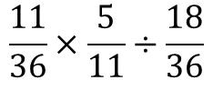
Let’s check that!
P(A)
P(B|A)
$$\frac{11}{36}×\frac{5}{11}÷\frac{18}{36}$$
P(B)

Slide 23
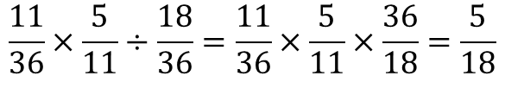
Let’s check that!
P(A)
P(B|A)
P(B|A)
$$\frac{11}{36}×\frac{5}{11}÷\frac{18}{36}=\frac{11}{36}×\frac{5}{11}×\frac{36}{18}=\frac{5}{18}$$
P(B)

Slide 24
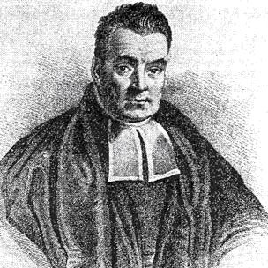
Introduction to (Bayesian) Statistics
Bayesian Reasoning

Slide 25
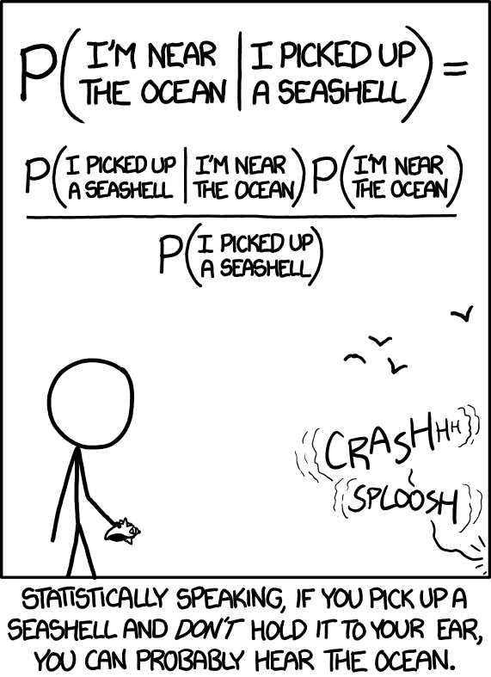
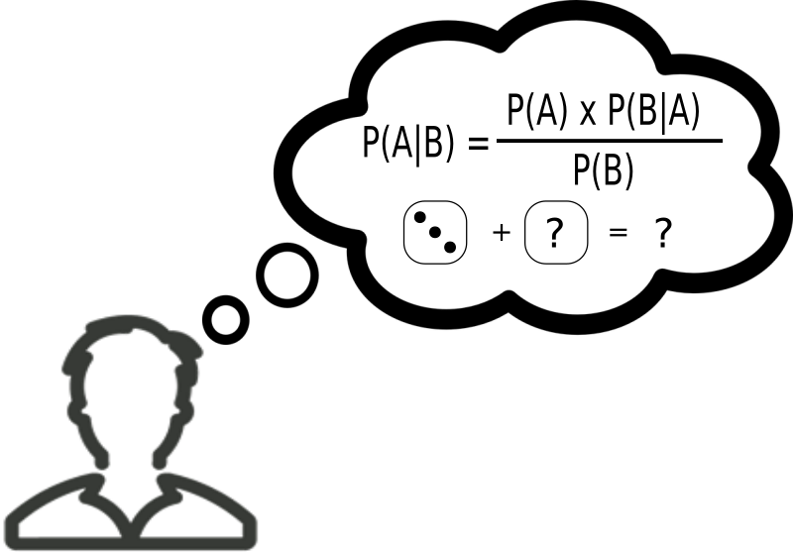
Bayes’ Rule
Bayes’ rule is a fact that all probabilities must obey.
What does this have to do with Bayesian statistics?
We get Bayesian statistics if we combine this rule with Bayesian probability.

Slide 26
Hypotheses and Data
H: A hypothesis about a coin.
D: An experiment providing some data

Slide 27


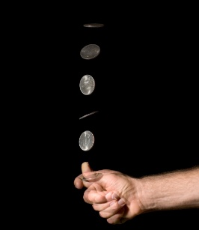
Hypotheses and Data
How much do I believe my
initial hypothesis …
= 0.5
.. given that I just observed
6 heads and 4 tails?

Slide 28
The posterior
= 0.5
The posterior probability that the hypothesis
is true, given that I have observed the data.
P(H)
X
P(D|H)
P(H|D)
=
P(D)

Slide 29
The prior
= 0.5
The prior probability that I observed to the hypothesis,
Before seeing the data.
P(H)
X
P(D|H)
P(H|D)
=
P(D)

Slide 30
The likelihood
The probability that I would have observed
the data if the hypothesis is true, i.e. the
likelihood of the hypothesis.
= 0.5
P(H)
X
P(D|H)
P(H|D)
=
P(D)

Slide 31
The marginal
P(H)
X
P(D|H)
P(H|D)
=
P(D)
The marginal probability that I would observe
the data at all, regardless of which hypothesis is true.

Slide 32
Using data to revise beliefs
P(H): The prior. My belief in the hypothesis
before seeing the data.
P(D|H): The likelihood. The probability
of observing the data if my hypothesis is true.
P(H|D): The posterior. My
revised belief in the hypothesis
after seeing the data.
P(H)
X
P(D|H)
P(H|D)
=
P(D)
P(D): The marginal likelihood.
The probability of observing the data,
regardless which hypothesis is true.

Slide 33
Introduction to (Bayesian) Statistics
Likelihoods and Bayes Factors

Slide 34
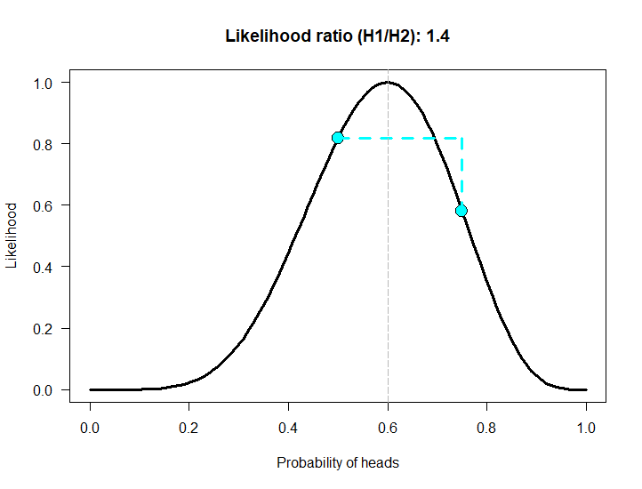
Using likelihood ratios
Comparing the evidence for two models
The likelihood quantifies the evidence the observed data provide for a hypothesis.
Compare the likelihoods of two competing hypotheses to determine which one is more likely (given the observed data).
Value of likelihood is meaningless by itself.
https://humburg.shinyapps.io/likelihood/
Figure based on https://alexanderetz.com/2015/04/15/understanding-bayes-a-look-at-the-likelihood/

Slide 35
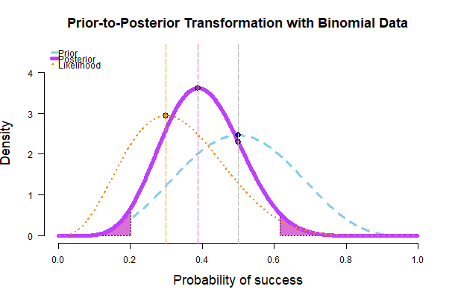
Updating priors with likelihoods
Prior encodes initial belief in possible parameter values (probability of Heads)
Likelihood quantifies the plausibility of different hypotheses in light of the available data.
The two combine to produce an updated set of beliefs, the posterior.
https://humburg.shinyapps.io/updating_prior/
Figure based on https://alexanderetz.com/2015/04/15/understanding-bayes-a-look-at-the-likelihood/

Slide 36
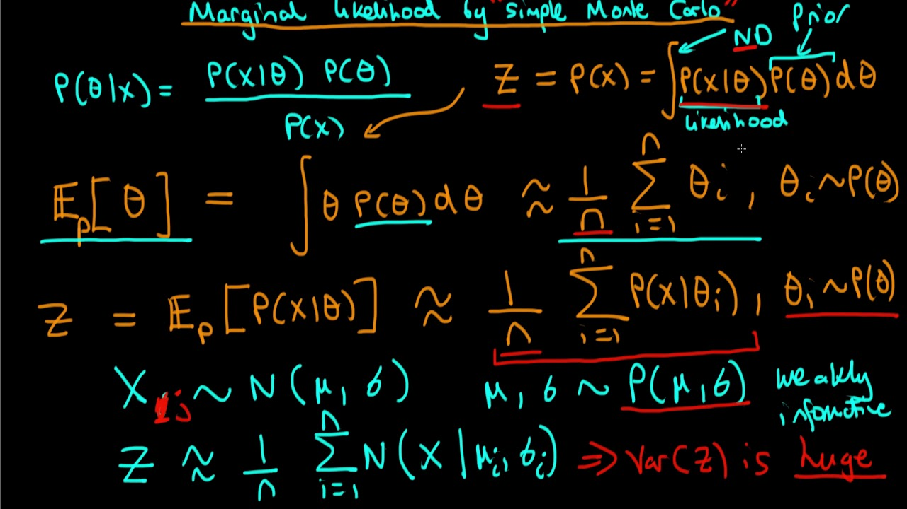
What about the marginal likelihood?
Can be difficult to compute.
Requires integrating over all possible hypotheses, weighted by their priors.
It is a normalizing constant that can often be avoided.

Slide 37
Bayes Factor
The likelihood ratio compares two point hypotheses.
What if we have more complex hypotheses?
Figure based on https://alexanderetz.com/2015/08/09/understanding-bayes-visualization-of-bf/

Slide 38
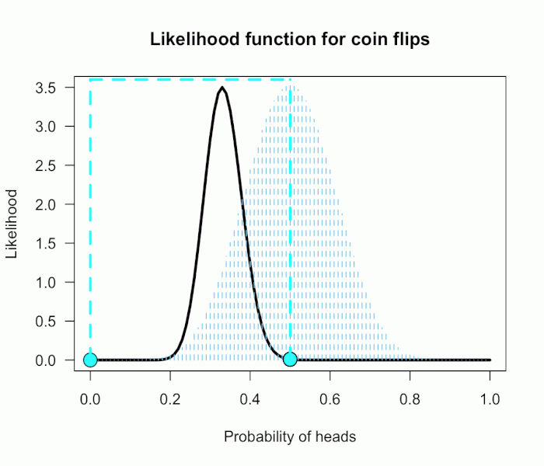
Bayes Factor
The likelihood ratio compares two point hypotheses.
What if we have more complex hypotheses?
The coin is fair vs it isn’t fair
If the coin is biased, how likely are all the possible probabilities for heads?
Compare the likelihood that the coin is fair to the average of the likelihoods corresponding to all possible values of P(heads) weighted by their priors.
https://humburg.shinyapps.io/bayes_factor/
Figure taken from https://alexanderetz.com/2015/08/09/understanding-bayes-visualization-of-bf/

Slide 39
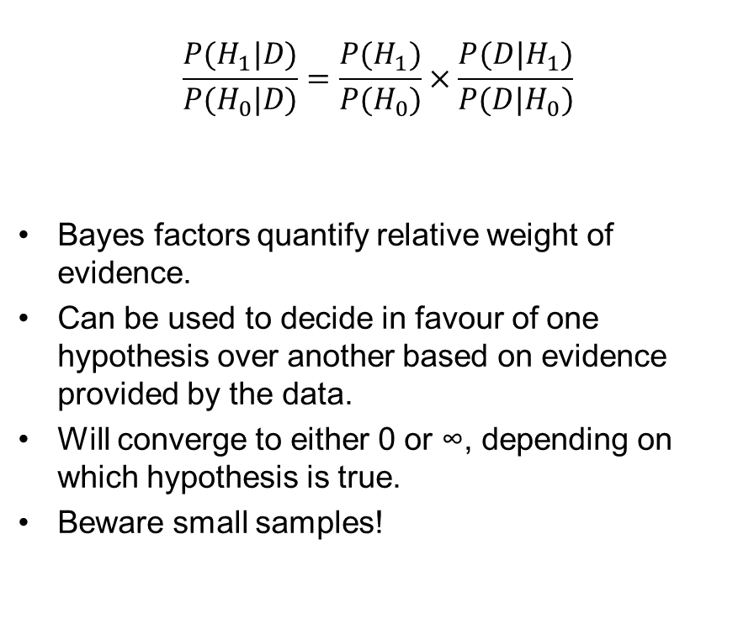
Bayes Factor
$$\frac{P(H_{1}|D)}{P(H_{0}|D)}=\frac{P(H_{1})}{P(H_{0})}×\frac{P({D|H}_{1})}{P({D|H}_{0})}$$
Bayes factors quantify relative weight of evidence.
Can be used to decide in favour of one hypothesis over another based on evidence provided by the data.
Will converge to either 0 or ∞, depending on which hypothesis is true.
Beware small samples!
Bayes Factor (H1/H0) | Strength of evidence
< 1 | Evidence favours null
1 - 3 | Barely worth mentioning
3 - 10 | Substantial
10 - 30 | Strong
30 - 100 | Very strong
> 100 | Decisive
Does this remind you of anything?

Slide 40
Using JASP
A quick tour

Slide 41

Download and install JASP

Slide 42

Open JASP

Slide 43
Bayesian Hypothesis Testing
Examples in JASP

Slide 44
Download data
Coin toss data
https://tinyurl.com/y8ro4ysf
Large coin toss data
https://tinyurl.com/y74hwe3u
Gap minder traffic death data
https://tinyurl.com/y8zz27rr
Weight perception data
https://tinyurl.com/ydfr8nlw
Or get it all from here:
https://github.com/humburg/Introduction-to-Bayesian-Hypothesis-testing/tree/master/data

Slide 45
A large posterior

